Slide 1
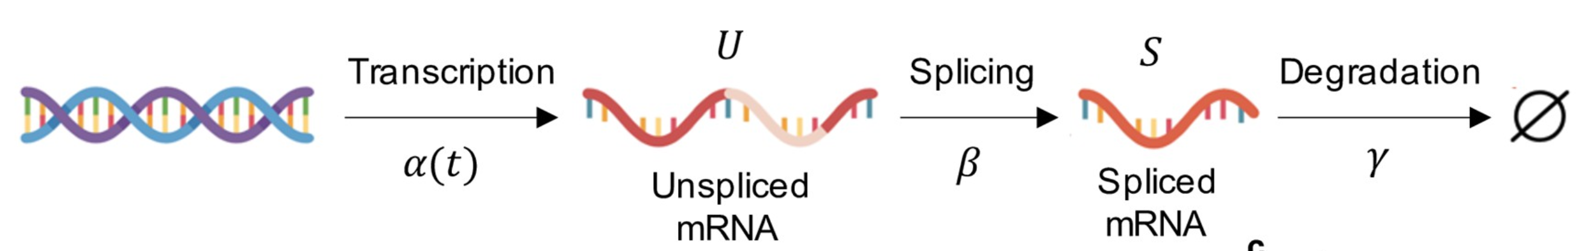
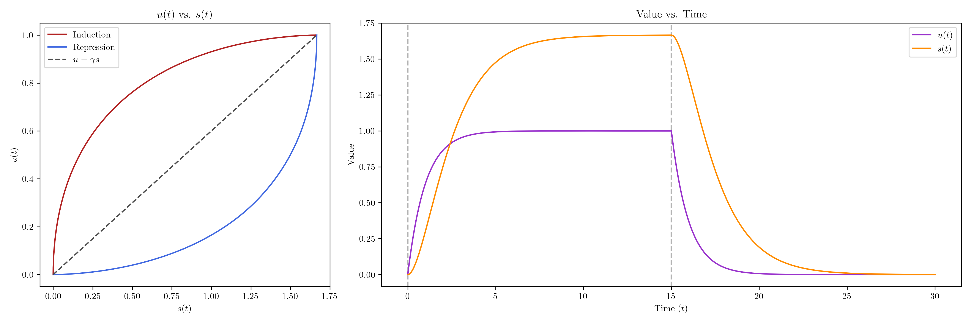
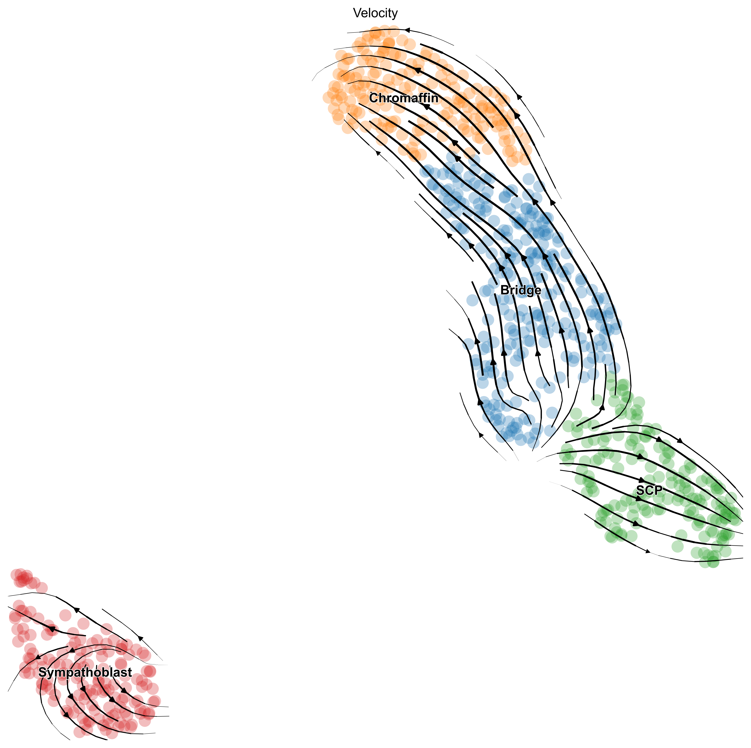
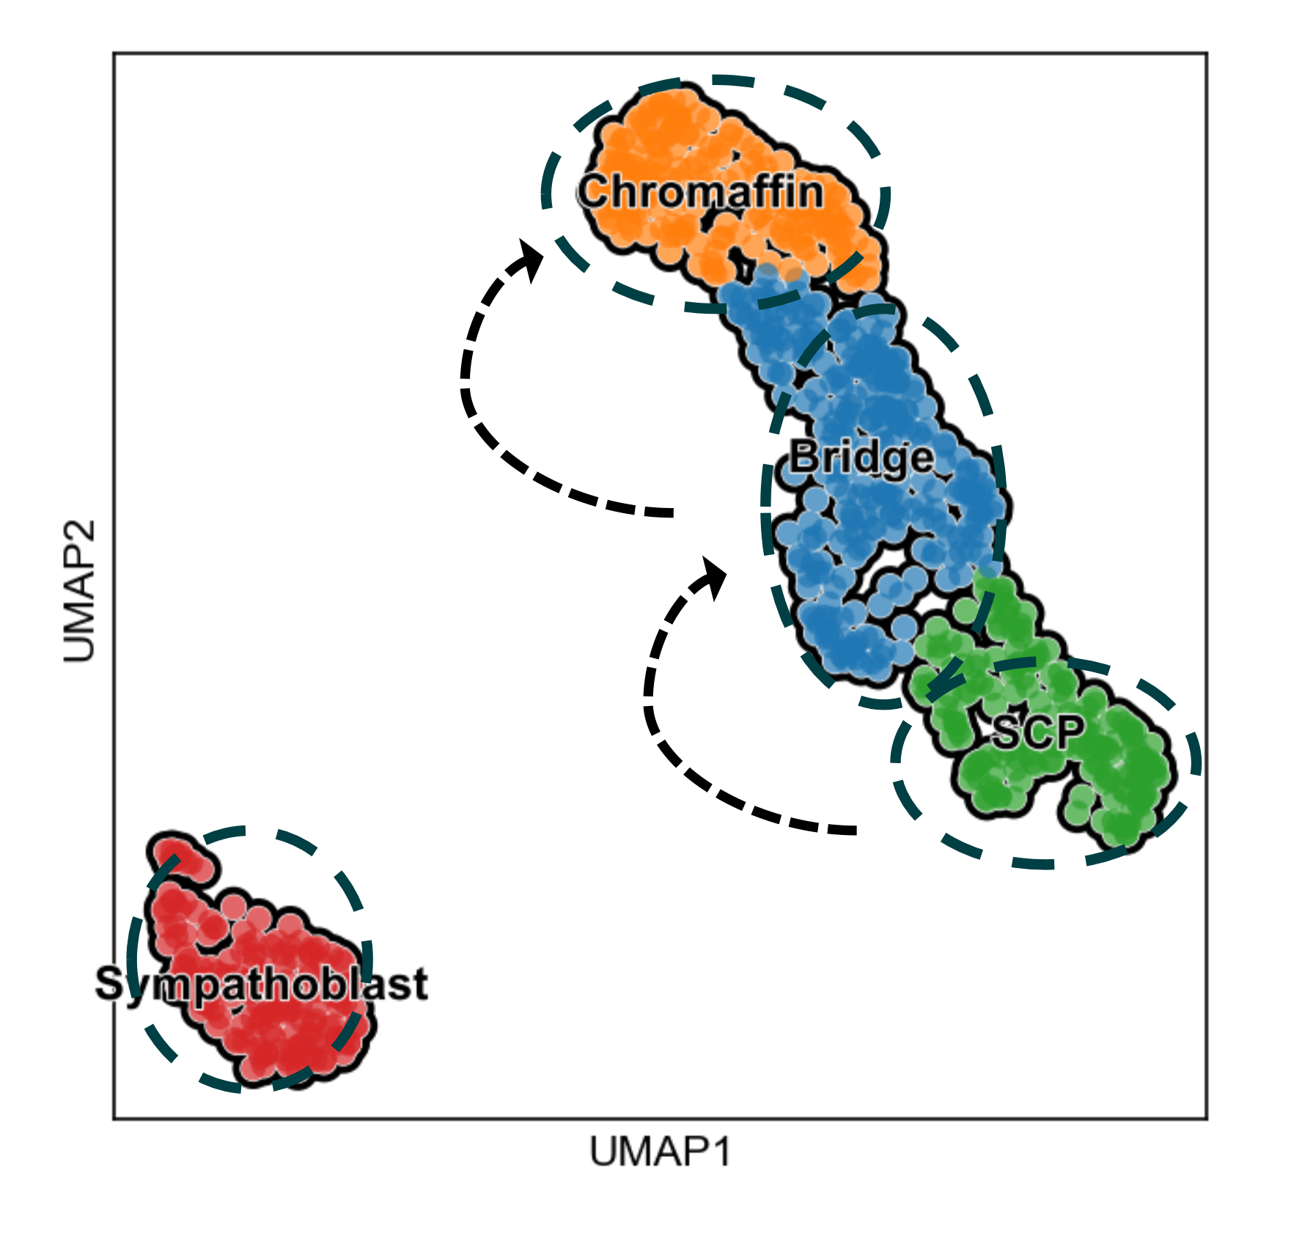
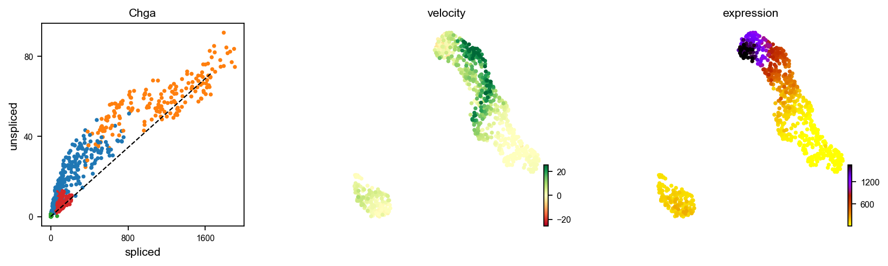
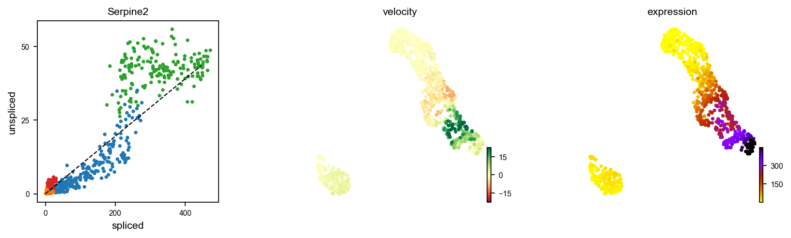
a
b
c
d
UMAP1
UMAP2
e
Notes:
Fig.1 | RNA velocity model applied on chrommafin scRNA-seq data.
a, Transcriptional model of mRNA processing in cell involving transcription, splicing and degradation.
b, Plots of unspliced and spliced RNA abundancy in cell with coefficients (??). Left, The phase portrait plot for the model under the assumption of \beta = 1 in all cells. Dashed line indicates the steady state, arrows indicates the development of time. Right, Dashed line indicates the time of sudden transcription initiation and termination.
c, RNA velocity graph with scVelo of mouse chromaffin dataset (La Manno et al., 2018).
d, Manual cell-type annotation results for the clusters and ground-truth devlopmental knowledge indicated with dashed arrows. SCP: schwann cell precursors.
e, Gene expression portrait of Chga (up) and Serpine2 (down). Chga is expressed in chromaffin cells, and Serpine2 in schwann cell precursors.

Slide 2
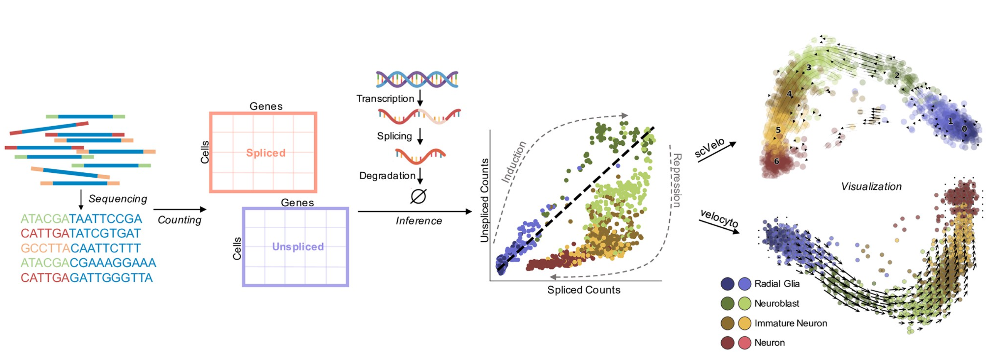
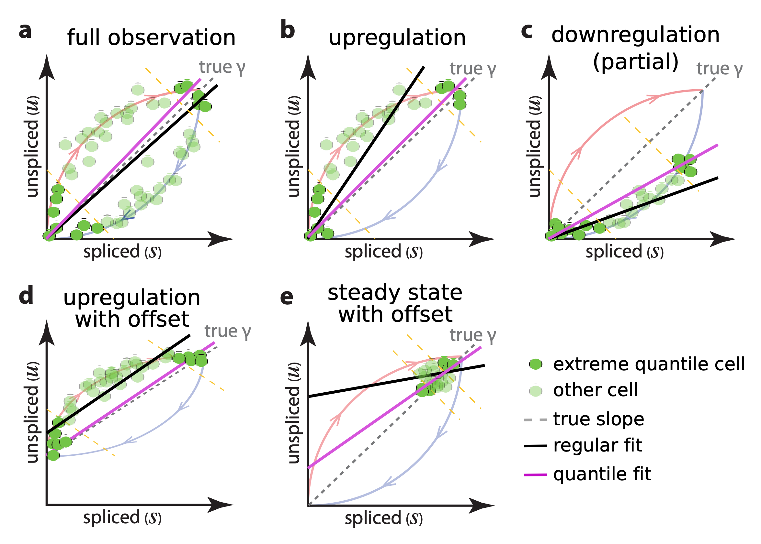
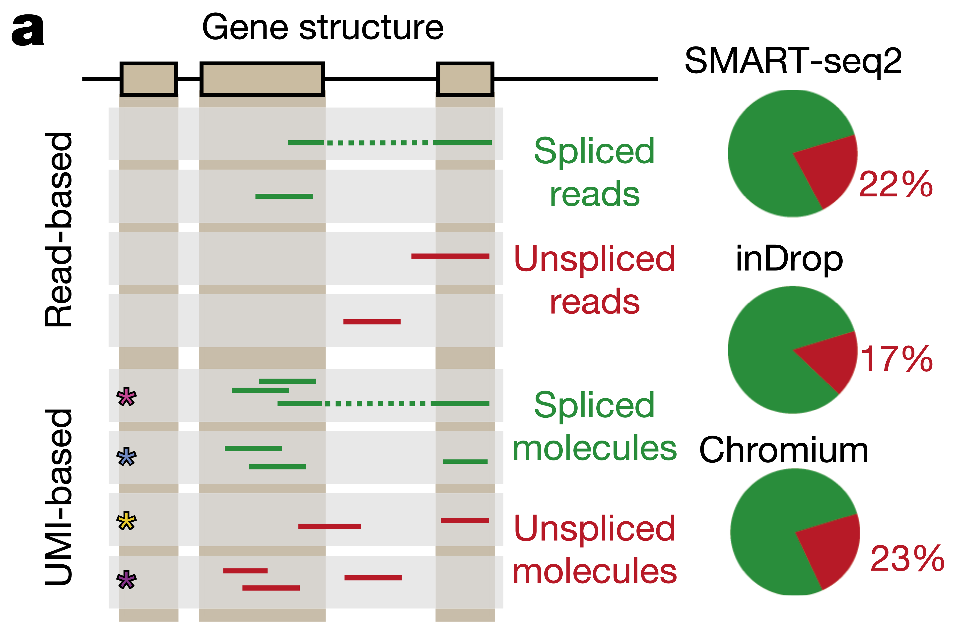
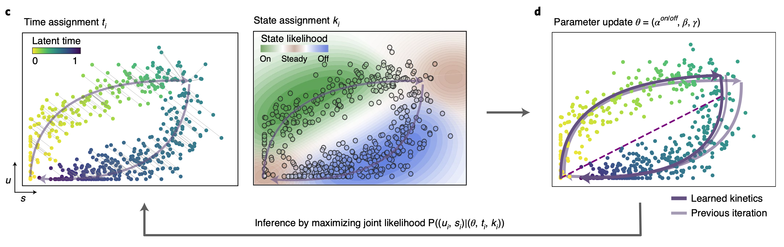
a
b
c
d
Notes:
Fig.2 | RNA velocity inference from scRNA-seq data.
a, Summary graph of a typical RNA velocity workflow (Gorin et al., 2022).
b, Spliced and un-spliced reads are mapped to different part of the gene. Pie charts indicates the percentage of un-spliced genes in different sequencing technologies (LaManno et al., 2018).
c, Percentile fit used by LaManno et al. (2018). The pink line (quantile fit) works better than regular fit under all conditions. By assuming a steady state at the extreme quantiles, rate coefficients can be found mathematically.
d, Maximum likelihood method for rate coefficient determination. Parameters of rate coefficients are updated iteratively with inferred time and state based on the spliced and unspliced gene counts from sequencing data (Bergen et al., 2020).

Slide 3
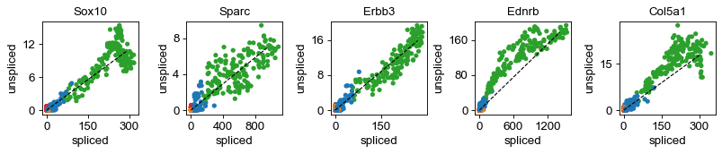
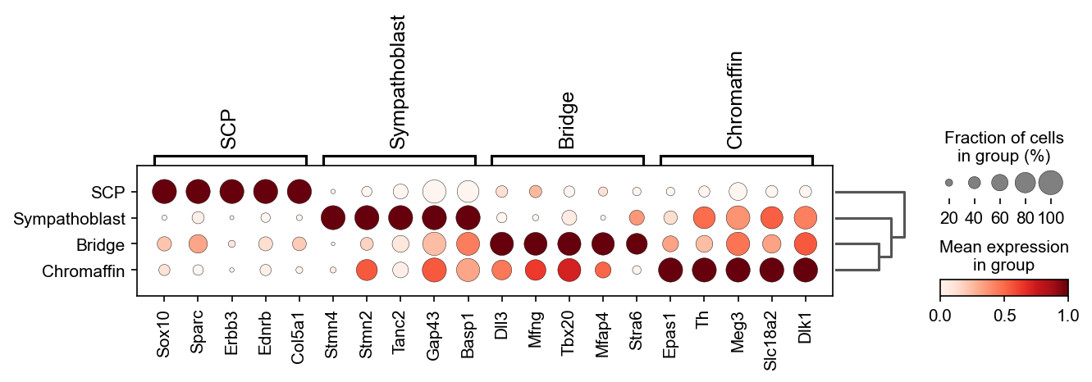
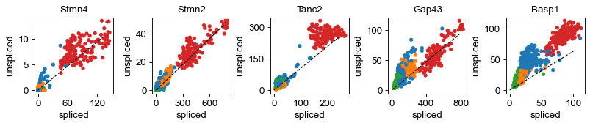
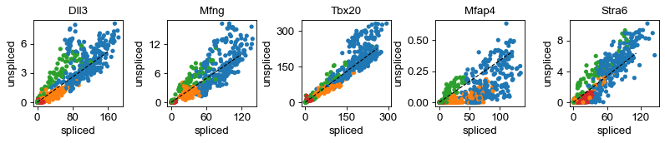
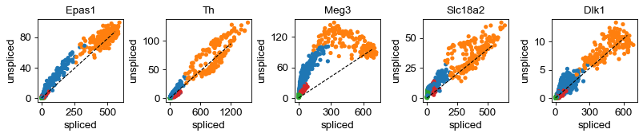
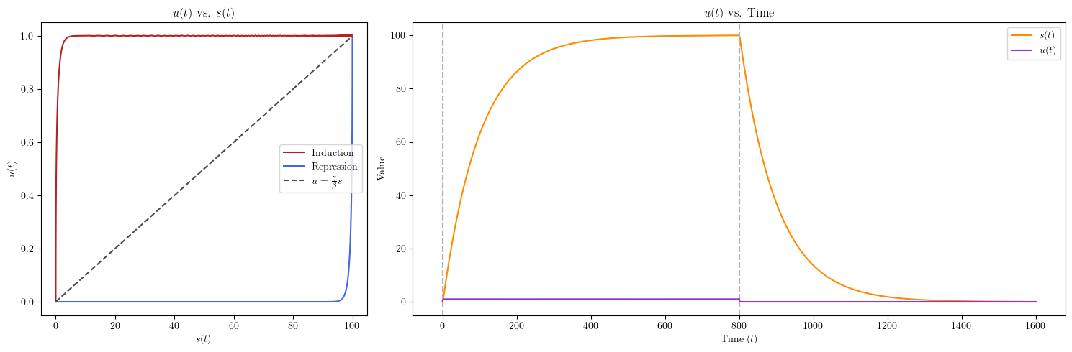
a
b
c
Notes:
Fig. 3 | Phase portraits of marker genes in different cells.

Slide 4
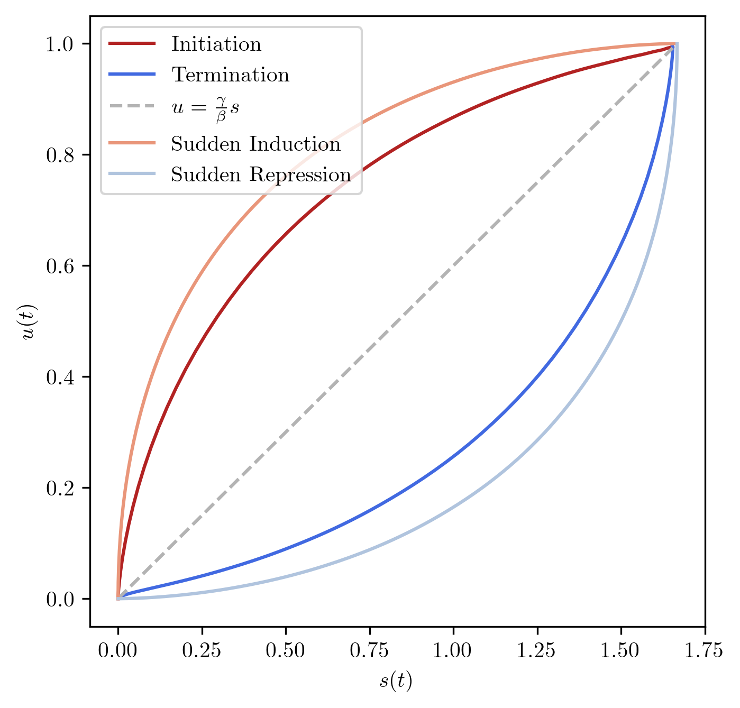
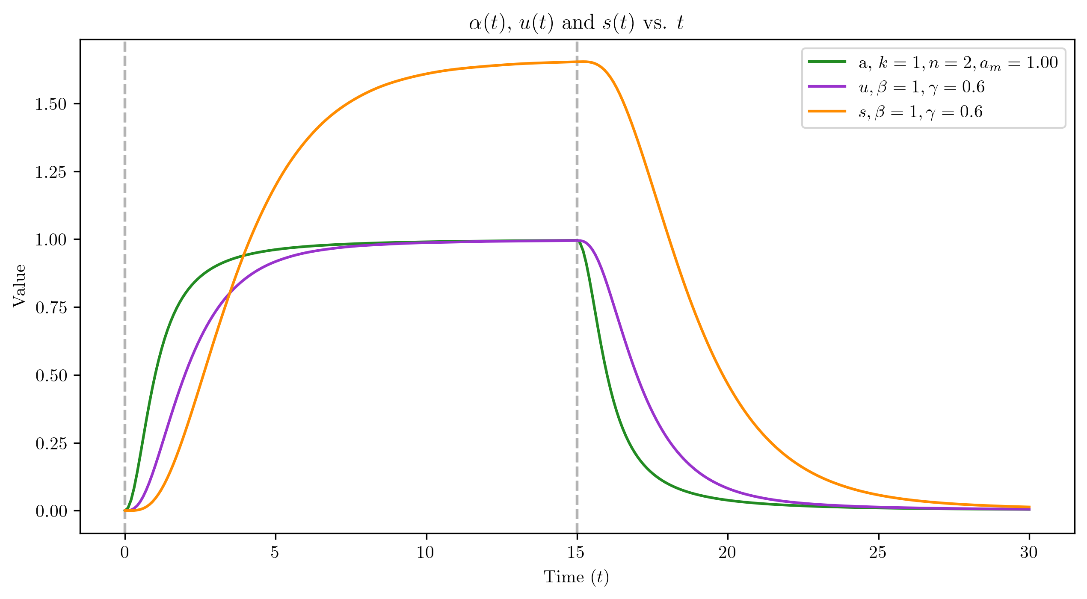
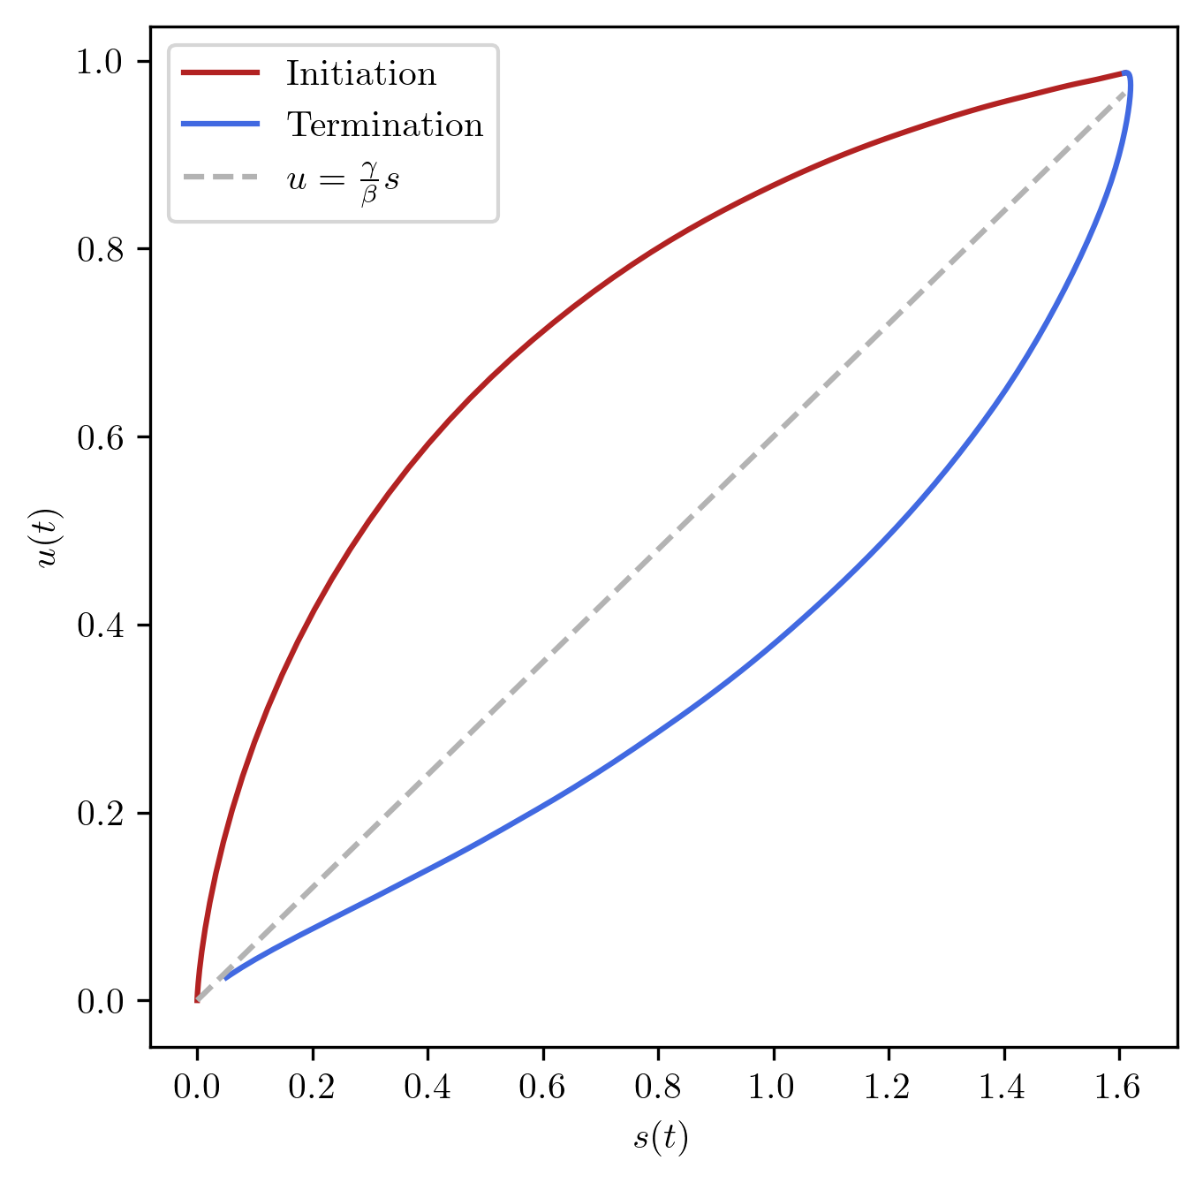
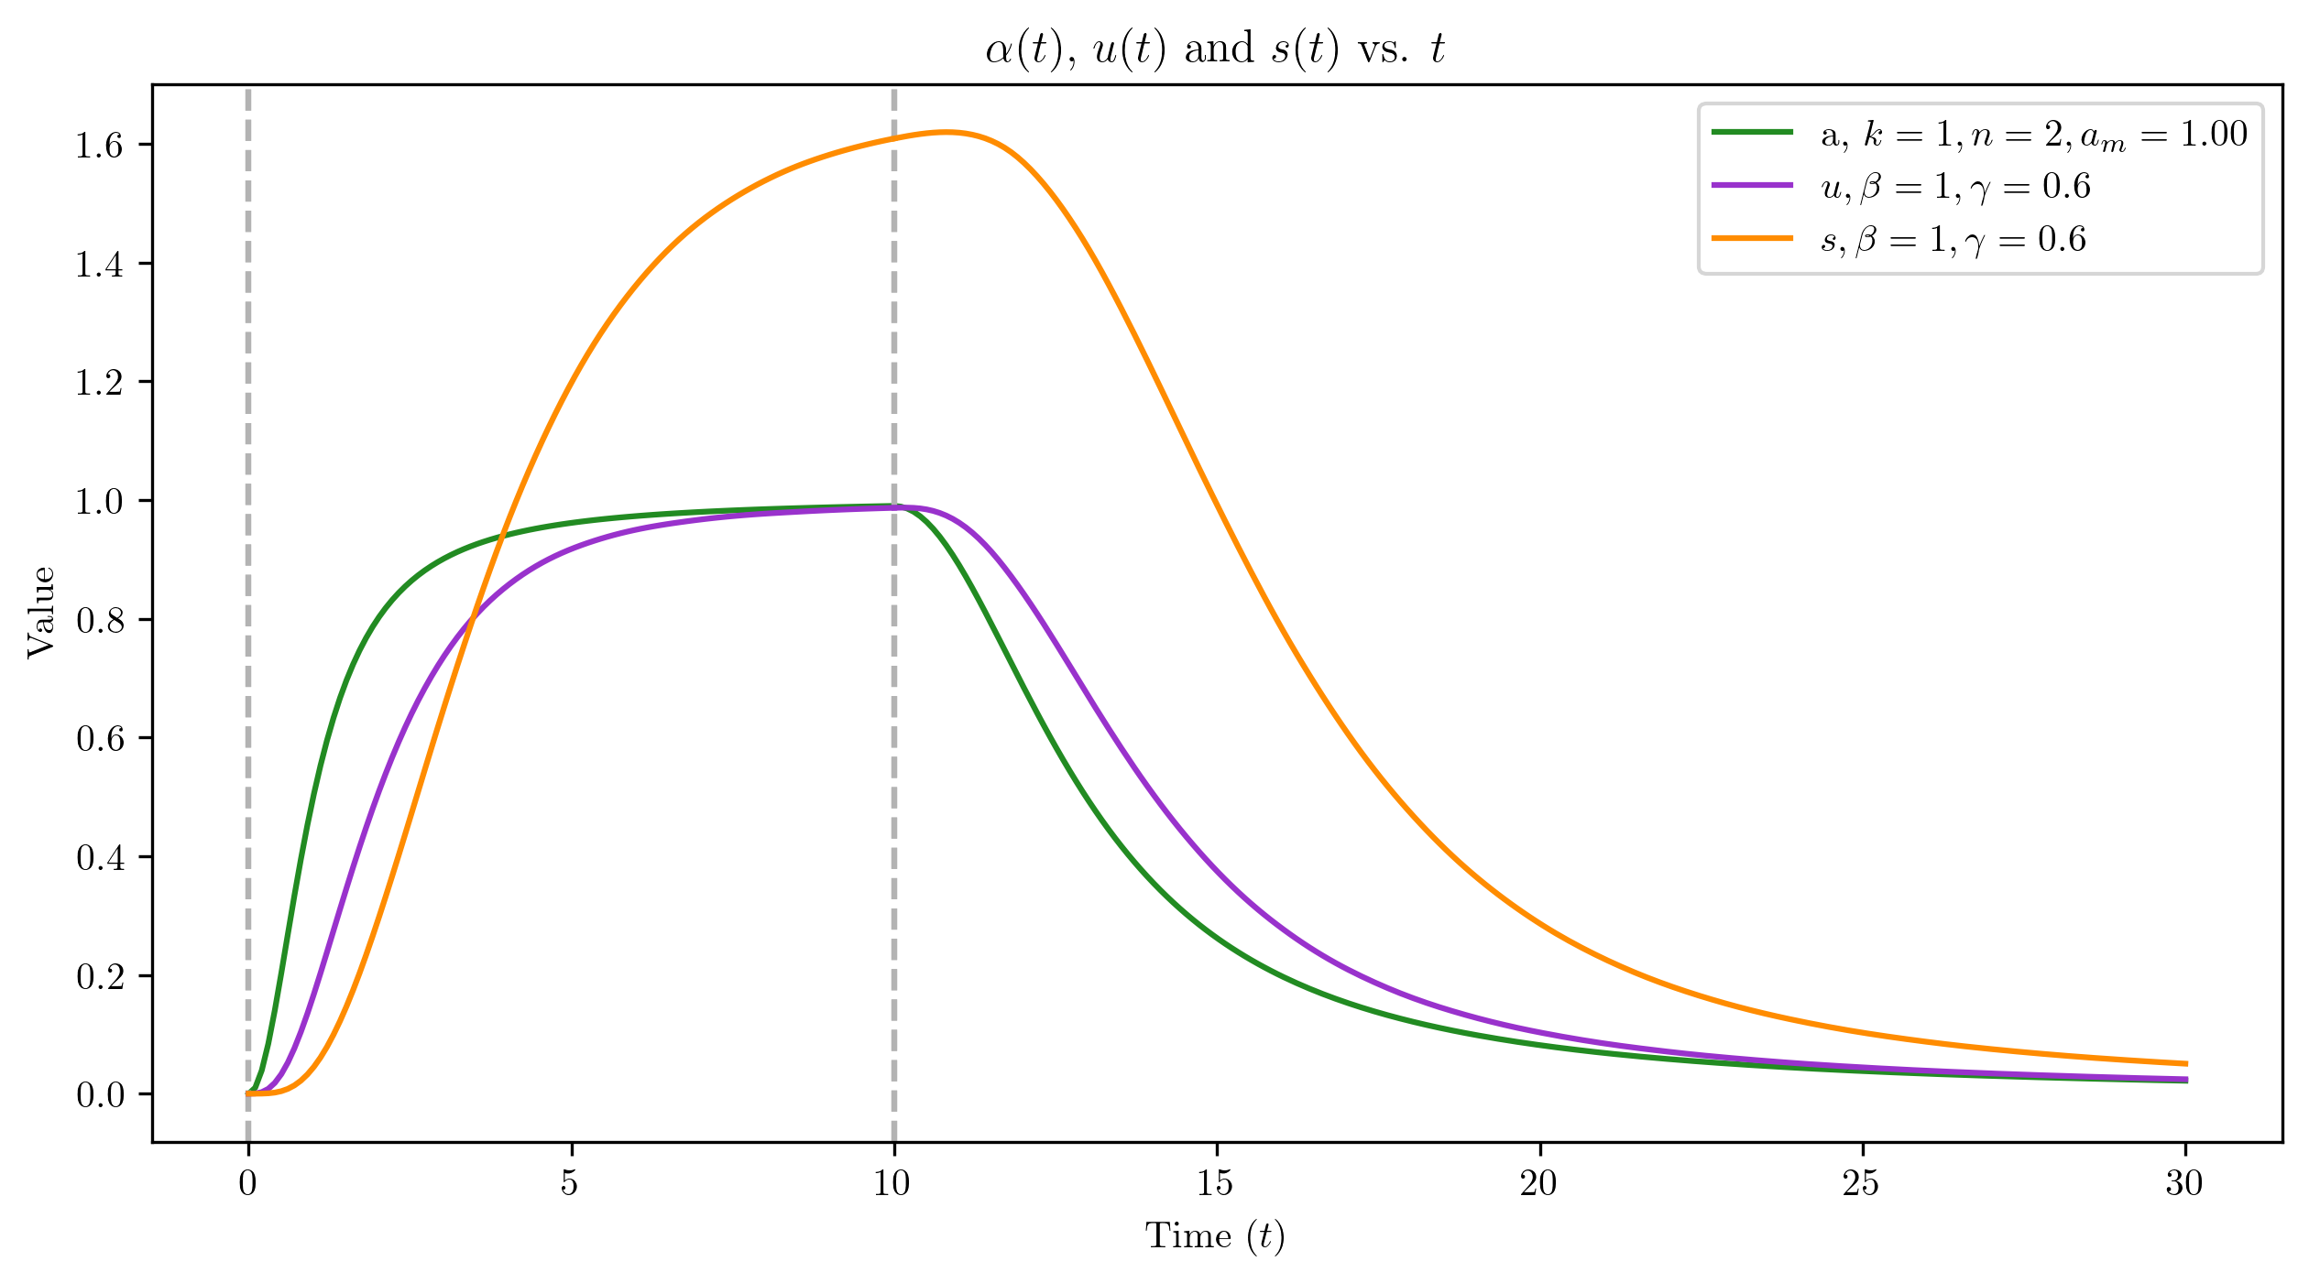
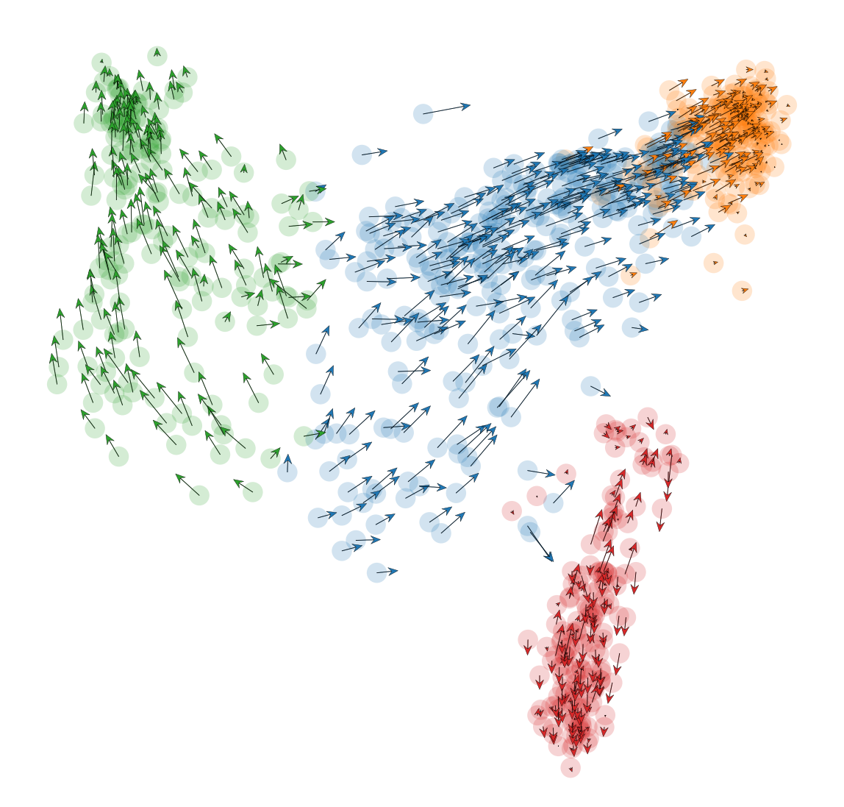
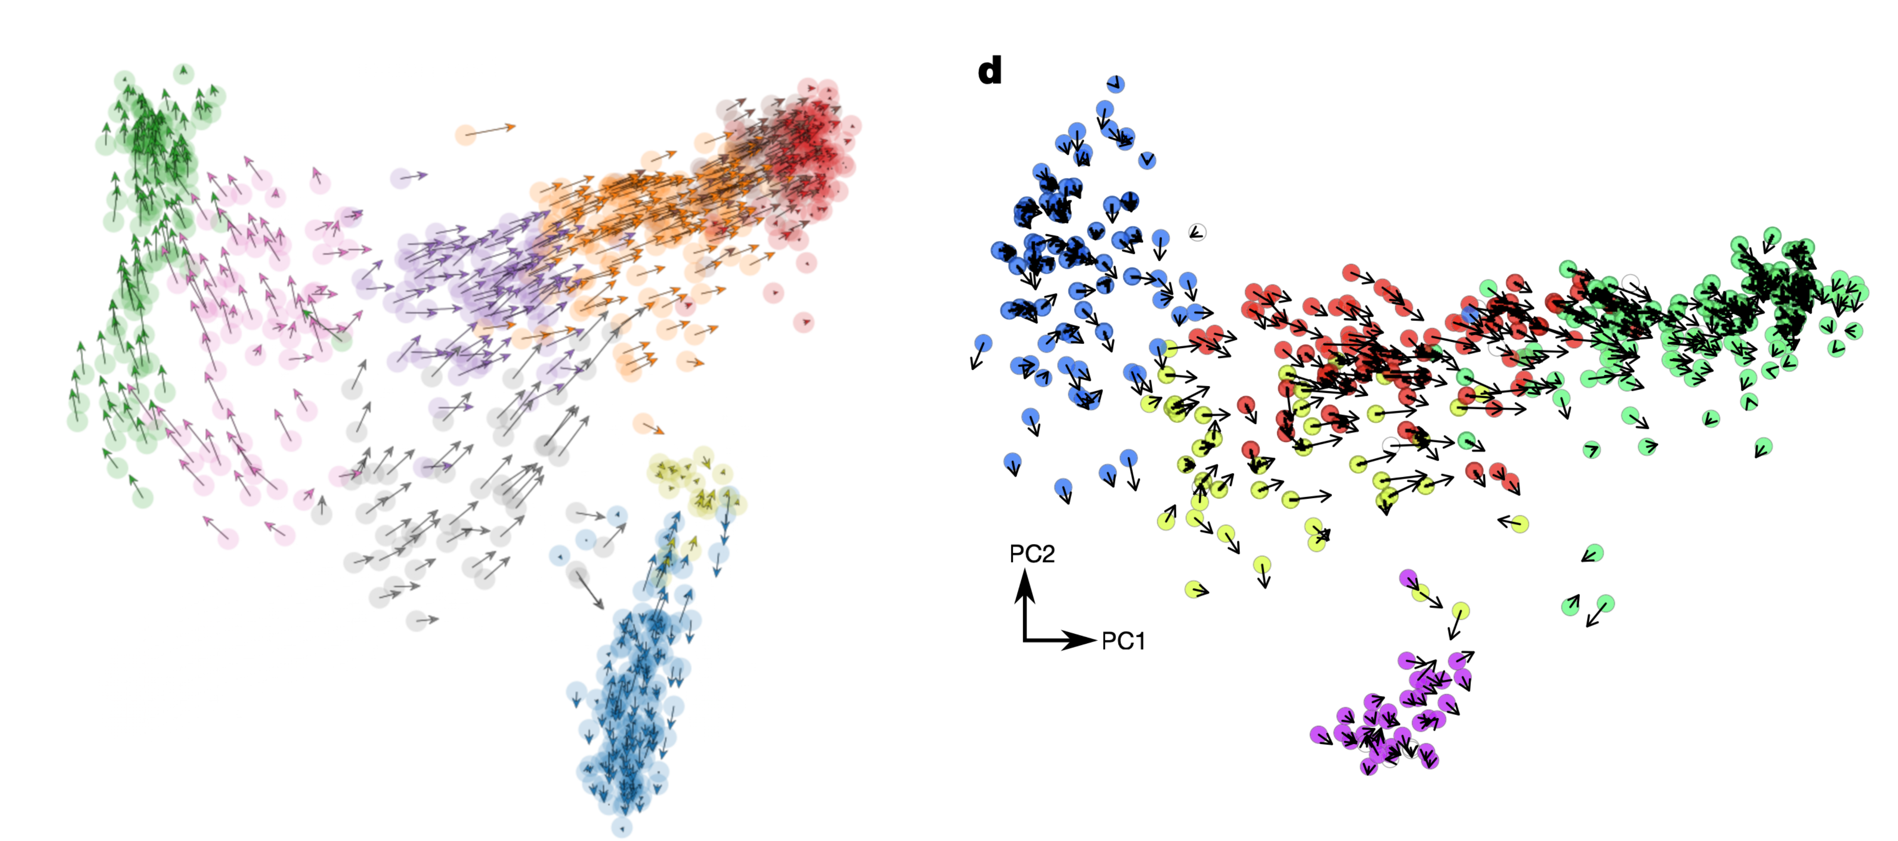
a
b
c

